Slide 1
Flying Through Clouds -
Navigating in an uncertain future

Slide 2
Acknowledgement
We acknowledge and pay our respect to the traditional Aboriginal owners of the land -the Dja Dja Wurrung- on which we live and work. We pay our respect to the first people of this country, their culture and Elders past, present and future. We also pay our respect to any other elders present.
We also recognise the privileges that we carry as white middle-class educated males in Australia and how fortunate our lives have been because of this.
Notes:
Tim to lead
After acknowledgement introduction of Tim and Chris, and seat of your pants – the journey to get here. Been involved in training and being trained for many years and thought we could do better – so put ourselves on the line here. We are learning and also going through this too – so appreciate any feedback, thoughts etc…
Why did we think this was important – acknowledge that this is a busy, crazy time and possibly telling you stuff you already know, but re-acquainting you with knowledge – and hopefully getting you to focus on you, and a chance to slow down and think
When we talk of privileges- we recognise that everyone's context is different and a responding to COVID 19 is all about the set of resources that people have

Slide 3
Today is about avoiding a crash, and also about ensuring a positive landing in the future
Notes:
Chris to lead
Chris intro re far side – first encountered Far side in a toilet in Vancouver in 1987 – shows how old I am…
in fact far side with Gary Larson’s bizarre humour is getting closer to reality
Both in personal and professional realms – we recognise the interconnectedness of these – your are who your are at work because of who you are at home.
Even if the economy is about to crash – we don’t need to!
This presentation aims to map out what might be happening for your self, your staff and your team. We will also provide some strategies for positively moving forward

Slide 4
Naming the beast
A little virus!
Rate these fears that a virus brings?
What does it mean professionally?
Future personal health
Future family health
Future financial health
Community impact
Spending so much time alone/with your family
Going to your local supermarket!
Notes:
Tim to lead
If we can name the beast we can tame the beast and ultimately we can move through to a positive place
How do we rate this event? Bigger than GFC, world war? Do you give it a different rating at home, or work? Different challenges for both, different benefits for both. Each of us will cope with different elements differently – extroverts and introverts may have different feelings about isolations (nothing different for gamers for instance- as opposed to someone who is already isolated)
Survivors guilt - Guilt for others who may be losing jobs/income
Does this provide us with an opportunity to reconsider our world/our democracy/ our systems/ the climate

Slide 5
Amygdala Hijack
Fear Stress Panic
Increased cortisol
Decreased mental capacity
Poor choices
Undesirable outcomes
Fight
Flight
Freeze
We need to break this cycle for ourselves so we can lead
But first how do you feel
Notes:
Chris to lead
Gives some context – this is actually how our body deals with this – and in the short term its good - when we see a tiger or a snake it gives us the tools to deal with it – but long term and that is where we are at with COVID 19 the increased cortisol puts on this downward cycle … and even though we might be feeling in control, we may be the frog in the pot – because everything has changed so quickly.
Some people are more affected by this than others (mental health issues, DFV, already isolated, not enough resources/infrastructure to isolate, relative O/S or aboriginal)
Could be issues such as personal connections/context which makes this bigger – live in small flat or open space, physical, financial, emotional resources
Adapt to that new normal – get back some control , help others get control
When oxygen masks drop down on a plane you need to fit yours first before helping others – so how are you feeling – what do you need to do to get into control
Compassion for others

Slide 6
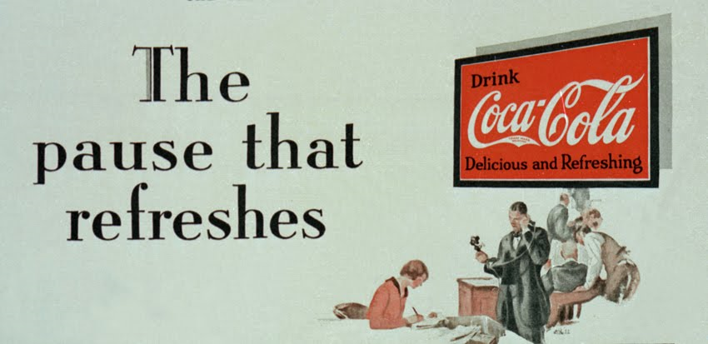
Break the cycle
Recognise – recognise what is happening ‘How am I feeling?’
Allow – allow life to be just as it is – ‘I’m scared – it’s uncomfortable but I can allow myself to feel this way’
Investigate – with kindness – ‘why do I feel this way?’
Non-identification ‘I am having a thought or emotion, but I am not that thought or emotion
Notes:
Tim to lead
The RAIN Strategy is a way of breaking the cycle – putting your oxygen mask on so you can help others
If you are feeling nervous, pause to consider why, and ask yourself if it's because you're doing something that matters to you and therefore reinforces your values and gives meaning to your life.
• Don't deny the stress, but redirect your energy away from it and toward the task at hand.
• If you are feeling overwhelmed with work or cares, try doing some small act of kindness for someone and note the mental reward you reap.
• Nurture your social networks. Caring creates resilience.
• Try to focus on the larger purpose of whatever you're doing. When you're stuck in a traffic jam taking your daughter to school, remember that it's because you love her and want her to get a good education.
• Whatever you're doing, don't pretend that stress doesn't exist. People who deny it tend to isolate themselves and reinforce their fears. Instead, ask yourself why you're experiencing this stress and look for any positive aspects to it. Are you learning something from it? Are you gaining strength? Are you connecting with people on a more fundamental level? Do you feel more intensely alive?

Slide 7
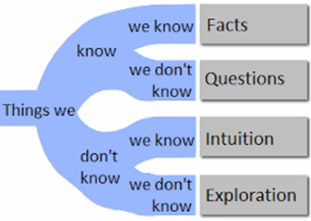
Fear today – gone tomorrow – Back in control
Notes:
Chris to lead
People may remember that Donald Rumsfeld talked about the unknown unknowns and got a bit lampooned for it, but maybe that is because it didn’t offer a pathway but just made us feel ignorant and kept us afraid – we could legitimately jump at shadows
Use this to give order to your work/life and give you a positive pathway for the unknown bits – you may not know where but you can work on how
Being able to sit with the unknown and being in control of what we can be in control of – sometimes we can be control of our questions, our intuition and our exploration- rather than just facts i.e. given we don’t know when this is going to end we are going to explore what it is like (thinking feeling and emotions) and/or what it is like to not know and/or what the current possibilities are like
It’s also a good reminder of the fact that we definitely know more than we think we know – and only when we get pushed do we discover it.

Slide 8
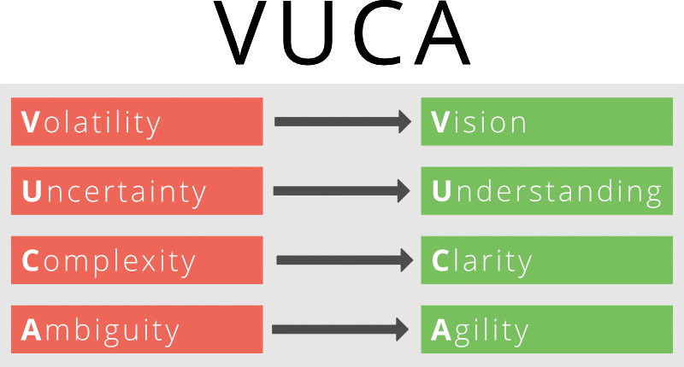
Living in a VUCA World
Notes:
Chris to lead
A term we got from the Us military the PG version of SNAFU
Impact of VUCA
Volatility – causes fear, risk aversion, and back to basics reactions
Uncertainty – causes paralysis through a tendency to invest in excessive and futile efforts on data analysis
Complexity – causes a desire to look for scapegoats or black and white solutions that are usually erroneous
Ambiguity – induces doubt and distrust and hesitancy, and impedes decision making and change
At SOYP we like to use our Re –approach
How do we reframe, rephrase redefine:
Vision – keep the big picture in mind all the time. Know what your vision is and keep working towards it
Understanding – Create security for people so they can get on with their job. Break down tasks into smaller achievable sections
Clarity/Communication – create clarity and focus. Accept what you do and not do and make clear decisions based on this information – communicate with transparency
Agility – Involve people, communicate as openly as you can and get feedback from others, listen to them – be open to new ideas

Slide 9
‘Hope’ - Martin (2008)
Hope plays a framing role in relation to our uptake, interpretation and deliberative use of information. (2008)
Like anything, it informs how we take in and react to the world.
Holding, engaging and using hope as a basis in how we communicate- becomes a deliberate act to support ourselves and others in a crises
We can be active in our engaging in hope – creating and spreading hope
Notes:
Tim to Lead
Hope is different from an optimism and wishing. Hope indicates we can be active in making change, even if it’s small.
It is important to understand the context of this – people start from different positions and have different factors that impact on their ability to ‘conjure’ hope, however, we all have the ability to fake it til we make it
Hope is a verb – a doing word

Slide 10
Tips to deal with ambiguity in the workplace
Define the framework
Understand your staff
Give clear and concise instructions to your employees
Make decisive decisions
Give training on resilience and confidence
Make sure employees take their vacations and lunch breaks
Encourage Mindfulness in the organisation
Notes:
Tim to lead
1. Define the framework
Set clear and achievable objectives. When employee engagement is high the levels of ambiguity will decrease. Even positive change can be stressful if the processes and outcomes are not clear.
2. Understand your staff
and their coping mechanisms for managing stress. Everyone will have different trigger points. Factor that into your dealings with them. The one size fits all, and a “need to suck it up and get on with it " vibe will not work long-term.
3. Give clear and concise instructions to your employees.
Don’t perpetuate and extend the ambiguity. Be clear in your instructions, reporting guidelines and benchmarks for success. Trying to read subtext and not knowing if there are subliminal messages can result in crazy-making thinking leading to further ambiguity.
4. Make decisive decisions.
That sounds like a duplication of words. It isn't and doesn’t imply an authoritarian process. A process can be collaborative, but at some point a decision has to be made. Take it and commit to it. Make that decision decisively, communicate it clearly and take action. Ambiguity leads to uncertainty and confusion. This is bad for morale and ultimately business. Concentrate on the decision that can be made- even if they are temporary or little
5. Give training on resilience and confidence.
Any exposure to scenarios that allow employees to hone their skills will allow them to do their jobs more effectively. A lack of confidence causes hesitancy and leads to ambiguity. This in turn generates a culture of no confidence.
Read: How companies benefit from confident employees.
6. Make sure employees take their vacations and lunch breaks.
In periods of uncertainty the general response is to throw people, time and energy at a problem. Very often the reverse is true. Rested, calm and measured energy is more productive than frantic "busyness."
7. Encourage Mindfulness in the organization.
Mindfulness helps focus on the moment and creates an awareness of a situation and any potential knee jerk reactions based on emotions. It also reduces the reliance on behaviours rooted in implicit bias and previous learned behaviour patterns. With practice it will eventually result in an ability to step back psychologically and emotionally to make calm decisions. It creates an awareness of your other thoughts and physical reactions.

Slide 11
Walking the Talk
Happy Failures – fail fast, recover quickly
Dealing with Blocking/Wimping/Hogging
The unknown space in front of us
Embracing cnaghe – recah out and tcuoh smeobdoy
Notes:
Chris to lead – if we have time – otherwise use as a tease to get to book into other courses
Some very simple fun games and activities to illustrate some of the concepts
Sometimes we block/wimp/hog things because then we can avoid dealing with it – at least in the immediate moment
Block just say no
Wimp – avoid answering directly, keep putting obstacles in the way – want to say yes but don’t want to commit – takes energy out of the interaction
Hogging – completely dominating the conversation – selfishness or sense of fear – don’t have trust in the partner/colleagues, if I dominate the space then I can’t be confronted..
Embracing change – we have the capacity to deal with it and do so all the time we are resilient

Slide 12
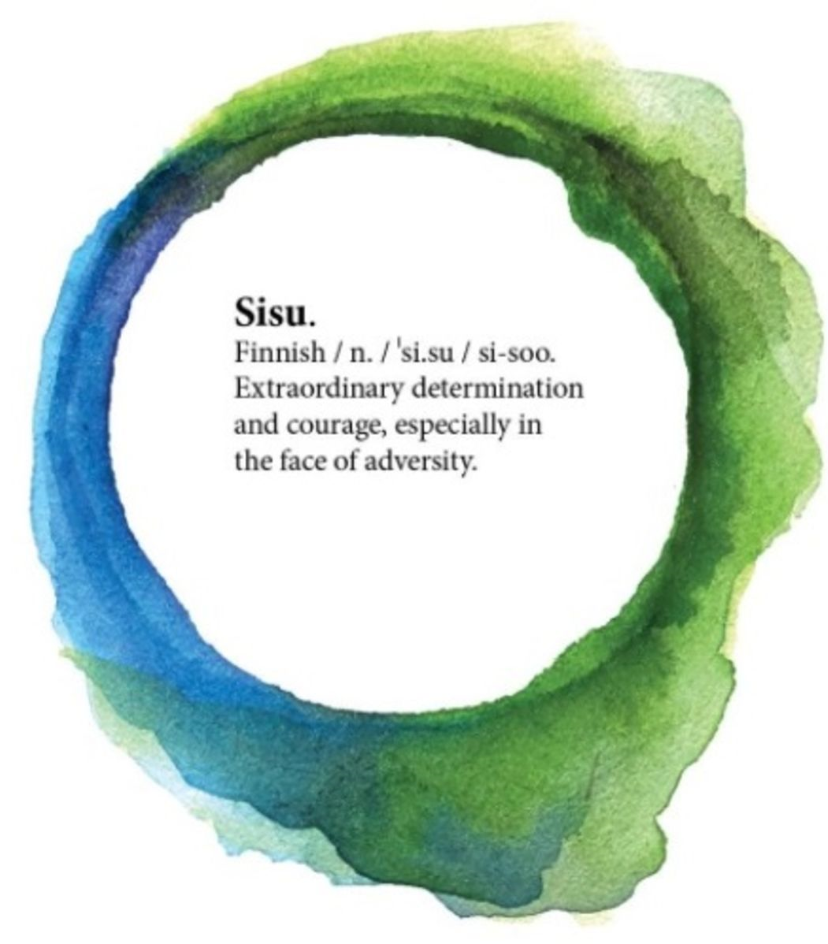
Develop sisu
Notes:
Tim to lead
1. Expose yourself to threats and breathe. Learn to relax when relaxation seems so foreign. By doing so, you may find that those situations you believe to be most threatening are really just your imagination playing tricks on you. Take away those somatic symptoms that often get you to think about your anxiety rather than actually take stock in the situation. I am not advocating that you wander like a lost child in a war zone; instead, I suggest you start with small steps.
2. Be present. Many of us adventurers use the phrase "Be Here Now" as a reminder that present thinking helps you concentrate, problem solve, and escape from situations that seem intractable. It might be convenient to start thinking about what not to do but I have found the affirmative of thinking about the present situation without drifting to what I could have done to prevent the situation or what the situation will cause in the future is far more powerful than the "don't do X" mindset that many adopt. Be proactive in being present. Think about the now.
3. Learn from your attempts. Every instance of exposing yourself and attempting to be present may not pan out as you expect. I recommend you take notes about each opportunity—from the most mundane opportunities to the major life events. By noting each (or practically each) situation, you may learn about your own tolerance of uncertainty. Challenge that intolerance.
what is now
what could be
how do we get there

Slide 13
be kind to others and yourself but be safe and buckle up (and book in to our 3 week course) contact on fly@soyp.com.au or call us Tim 0408 176 218 Chris 0447 976 831
Notes:
Tim to lead and wrap up
Shameless self promotion
Feedback

